Slide 1
Current Progress – Paul Minner
Spring Break
Sped up obstacle avoidance system.
Integrated ECE Device Controller Code
Created two compilation options, test and final.
Unable to extensively test.
Re-Organized Repo and Improved ReadMe
Added compilation instructions.

Slide 2
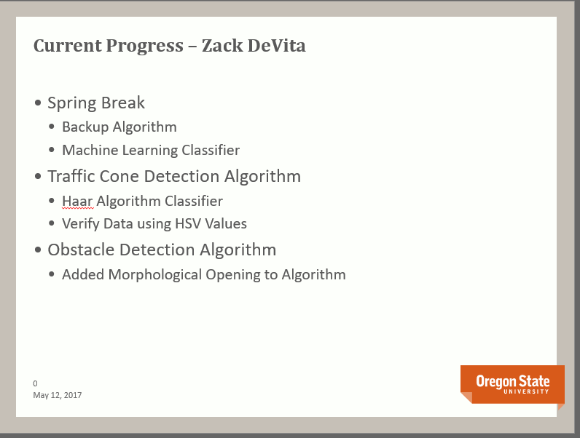

Slide 3
Current Progess – Zhaolong Wu
Spring break
Writing the test cases for the navigation module
Update the navigation module
Redesigned the navigation algorithm to determine the rover’s initial heading
Rescue rover when it lands on its side
Redesigned the module due to the servo’s limitation

Slide 4
Current Progress – Steven Silvers
Control Board
ECE team has received final board
Wheel System
Redesigned to hold motors better
Obstacle Avoidance
Testing with PI Camera

Slide 5
Problems Encountered
Missed Deadlines
Fried components
Motors didn’t fit frame

Slide 6
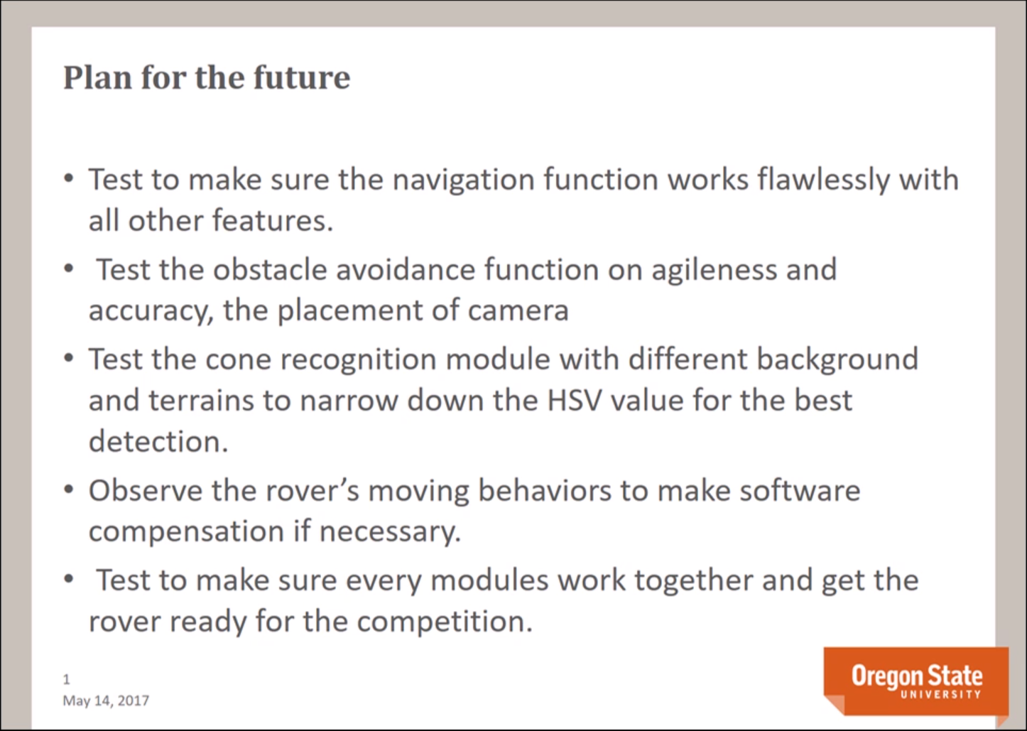

Slide 7
Elevator Pitch: Technical Audience

Slide 8
Elevator Pitch: General Audience

Slide 9
End of Presentation

